Slide 1

Introduction to CS102 and CS103
Orientation for Science Students
22 September 2022
This session is being recorded, so please turn off cameras video and microphones.
The presentation will last approximately 30 minutes, followed by a Question & Answer session.
Use Chat to ask questions

Slide 2

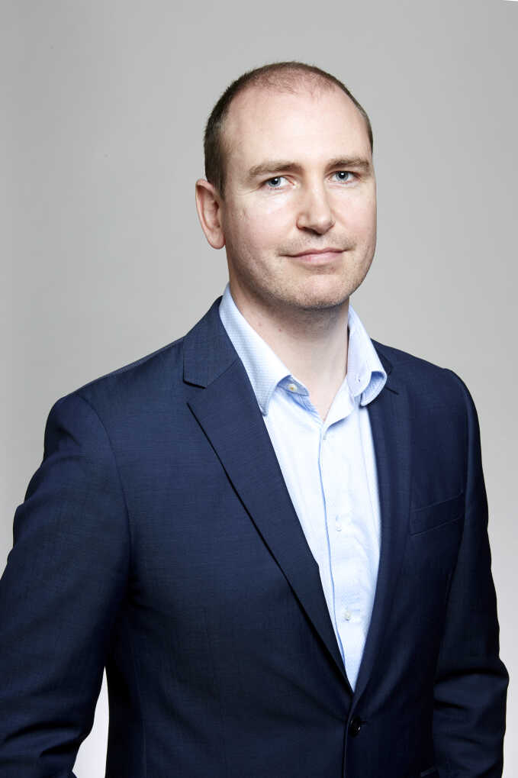
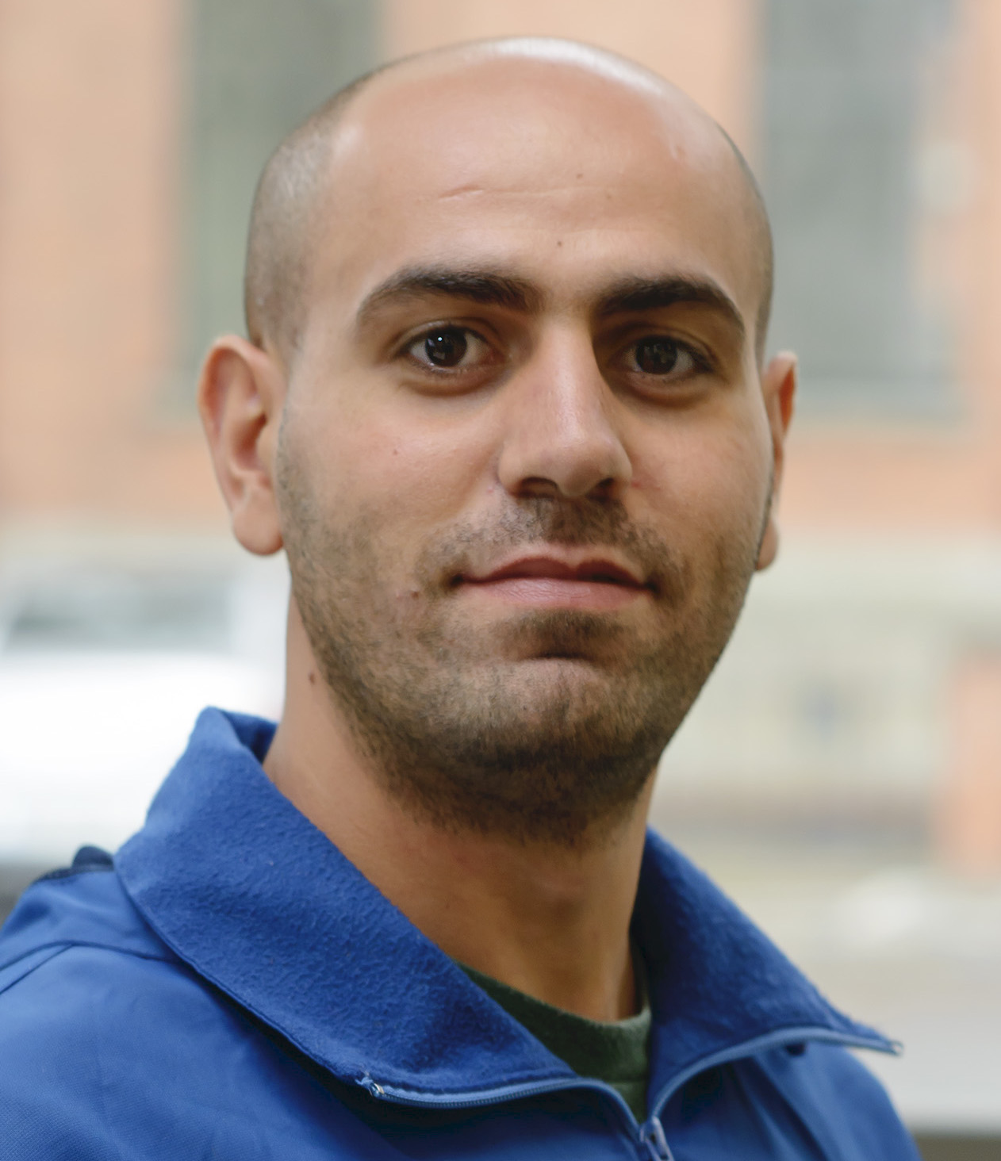
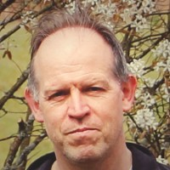
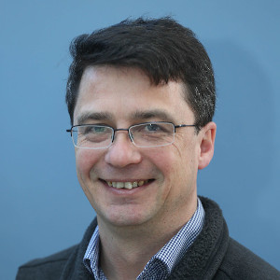
Introduction to CS102 and CS103
Lecturers:
Semester 1:
Dr Niall Madden (CS103 and CS102) and
Dr Takfarinas Saber (CS102)
Semester 2:
Dr Mark Howard (CS102) and
Dr Michael McGettrick (CS102)

Slide 3
What are CS102 and CS103, and why should I take them?
CS103 is a self-contained introduction to computer programming. It is required for students in
Financial Mathematics and Economics
Mathematical Science
Physics
Genetics and Genomics
CS102 gives broad foundation in computer science and programming.
It is part of GY301, and core to the Pathways:
Mathematics and Computer Science
Mathematical Studies and Computer Science
Computer Science
Data Science
Can also be taken in GY318.
CS102 includes all of CS103

Slide 4
What are CS102 and CS103, and why should I take them?
Programming skills are useful in all areas of science!
Examples:
Simulations and numerical experiments
Automation
Processing large data sets

Slide 5
How are CS102 and CS103 organised?
CS103 students will have two lectures each week in Semester 1.
CS102 students will have three lectures each week during both semesters.
Semester 1: all groups have 3 hour lab sessions, starting Week 3 (from October 10th)
Details of labs to be confirmed in the next 2 weeks.
Semester 2: Lab sessions for students in CS102.

Slide 6
CS102 Semester 1 Schedule
When | Where | Who | What
Tuesday at 14.00 | AC202 | Tak | Computer Systems
Wednesday at 13:00 | MRA-201 (TBC?) | Niall | Intro to Programming
Thursday at 9:00 | AMB-1022 | Niall | Intro to Programming
Mon, Tue, Wed 15:00-18:00 | Various locations | Niall + Grad Students | Python labs
First lecture: Tue 27th Sept (Tak)
First lab: Week 3 (Week starting 10 October)

Slide 7
CS103 Schedule
When | Where | Who | What
Wednesday at 13:00 | MRA-201 (TBC?) | Niall | Intro to Programming
Thursday at 9:00 | AMB-1022 | Niall | Intro to Programming
Mon, Tue, Wed 15:00-18:00 | Various locations | Niall + Grad Students | Python labs
First lecture: Wed, 28th September (Niall)
First lab: Week 3 (Week starting 10 October)

Slide 8
CS102 Assessment
Semester 1:
5 Python Programming assignments: 40%
Two class tests on Python: 13% each
Quizes on Computer Systems: 34%
No final exam
Semester 2: See presentations by Michael and Mark

Slide 9
CS103 Assessment
5 programming assignments: 60%
Two class/lab tests: 20% each
No final exam

Slide 10

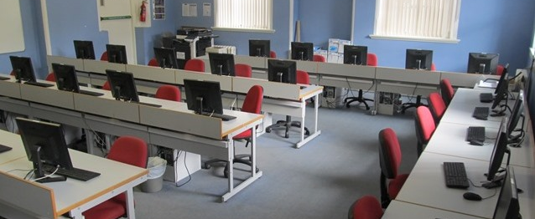
What are labs?
Labs take place in PC suites on campus (may switch to lecture rooms in Week 10).
They start in Week 3.
You'll complete Python programming assignments, supported by a team of graduate and undergraduate students, who will give 1:1 assistance.

Slide 11
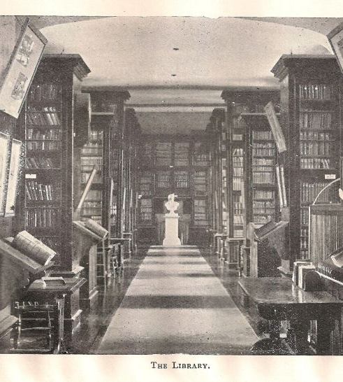


What Background and Resources do I need?
You do not need any previous programming experience.
Some books will be recommended (especially for Semester 1 programming), but are freely available. You don't need to buy a book.
Having a laptop (with keyboard; not tablet) is VERY useful, but technically not essential.
Access Centre Laptop scheme: Deadline 15 October. https://www.universityofgalway.ie/accesscentre/laptoploanscheme/
You won't need to install software on your own computer.

Slide 12
CS102 Module Content
Introduction to Programming (Niall)
Computer systems (Tak)
Algorithms and Data Structures (Michael)
Advanced Programming (Mark)

Slide 13
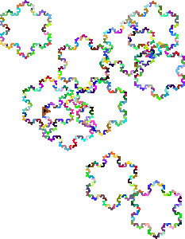
CS103/ CS102 Semester 1 Programming
Contact: Dr Niall Madden
Niall.Madden@UniversityOfGalway.ie
Wednesdays and Thursdays, and Weekly Labs

Slide 14
CS103 Module Content
CS103 will focus on the practical side of programming and software development. This module provides an introduction to computer programming using Python and Jupyter notebooks.
Some topics:
Numerical and text data types and their operations.
Basic language constructs (e.g. control structures).
Applications.
We'll cover concepts in lectures (2 per week)
Practical work in Labs:
attend one session per week,
Mon-Wed, 15.00-17.00.
Contact: Dr Niall Madden (Niall.Madden@UniversityOfGalway.ie)

Slide 15
CS103 Module Content (in detail)
Getting started with Python and Jupyter
Strings and text processing
Variables and expressions
Functions
Loop, iteration and recursion
Contionals and decision points
Input and output
Tuples, lists and dictionaries
Classes and objects
Files and storage
Modules and packages

Slide 16

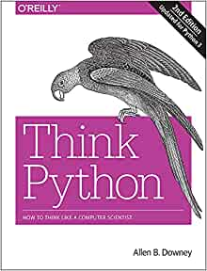
CS103 Background and Resources
CS103 will focus on the practical side of programming in Python.
We'll use Jupyter notebooks web interface, so you don't need your own laptop.
Textbook: Think Python: How to Think Like a Computer Scientist, by Allen B. Downey. Free from https://greenteapress.com/thinkpython2/html/index.html
Help available in labs and ComputerDISC, and the laptop loan scheme.

Slide 17
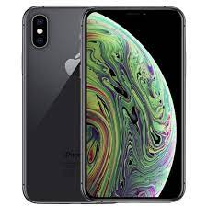
CS102 Computer Systems
Contact: Dr Takfarinas Saber
Tuesdays, Semester 1.

Slide 18
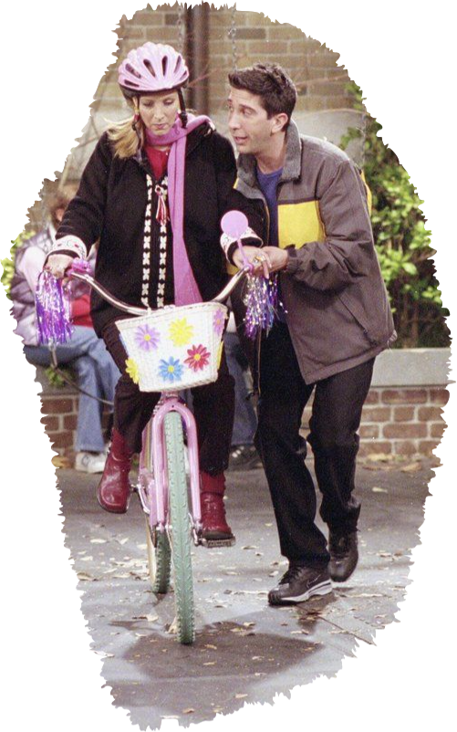
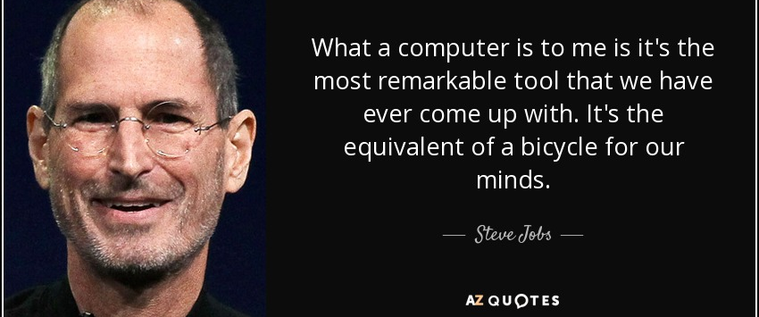
Bicycles for our Minds
Getting to know what is a computer and how it works
Notes:
Steve Jobs: “What a computer is to me is it’s the most remarkable tool that we have ever come up with. It’s the equivalent of a bicycle for or minds”
+> Before learning how to ride, you need to know what is a bike and how it works.

Slide 19
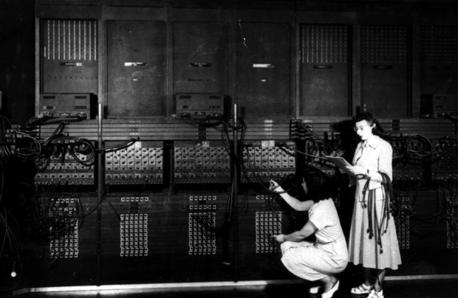
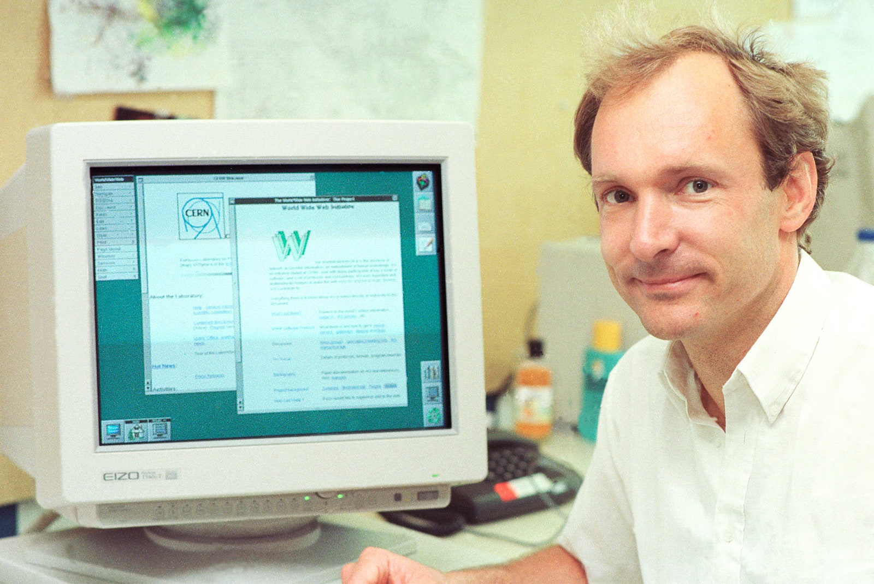

Evolution of Computing
1945:
ENIAC ‘The Giant Brain’
The 80s/90s:
PCs and Web
The 2000s:
Personal and Mobile Computing
Notes:
‘Programming was done manually by plugging cables and setting switches, and data was entered on punched cards. -
The original programmers of ENIAC computer were women.
Programming for typical calculations required from half an hour to a whole day

Slide 20
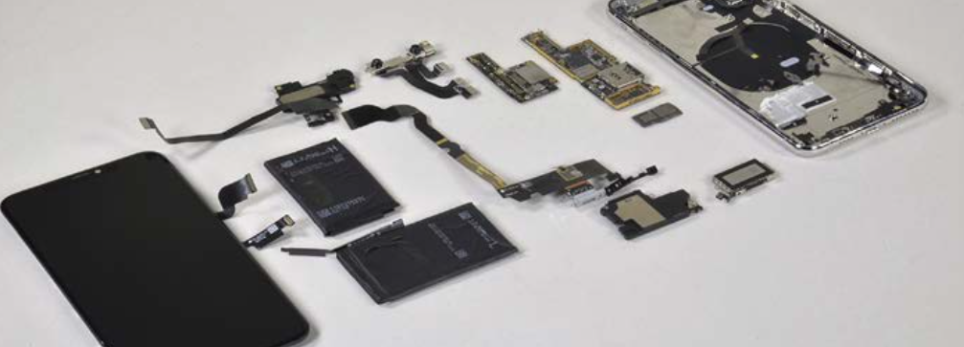
Apple iPhone XS Max smart phone
At the left is the multitouch screen and LCD display.
Next to it is the battery
To the far right is the metal frame that attaches the LCD to the back of the iPhone
The small components in the centre are what we think of as the computer
This is similar to what you might find in laptops and PCs

Slide 21
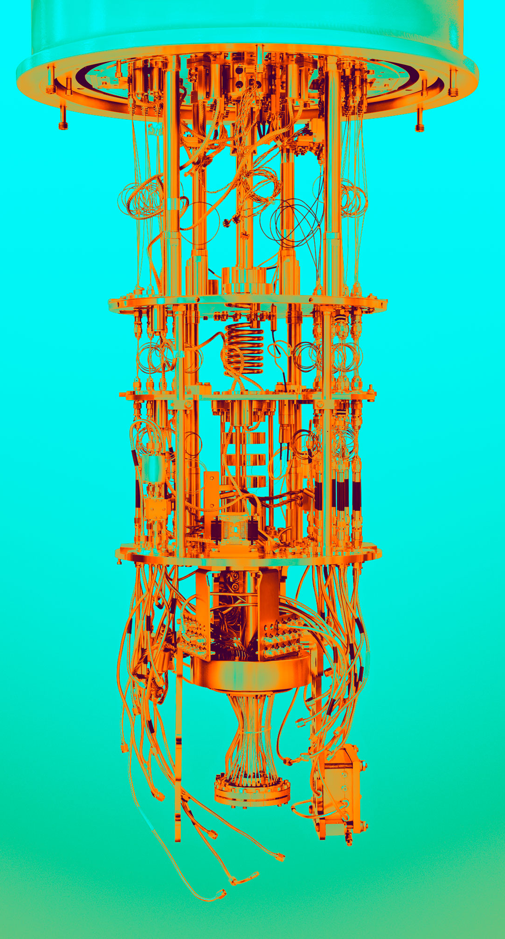
CS102 Further Programming
Contact: Dr Mark Howard
Wednesdays, Semester 2

Slide 22


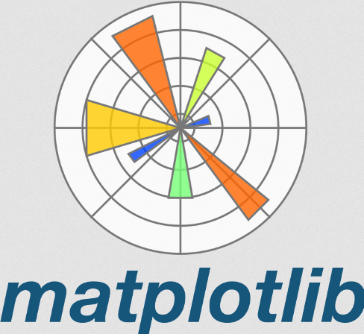
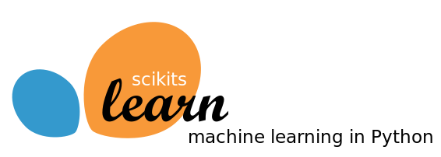
CS102 Further Computing
Semester II: 1 Lecture per week
Final Exam: 2 out of 6 Questions on Exam
Description:
Python has libraries that extend its functionality.
We will learn the basics of some important libraries, and put all this together…

Slide 23
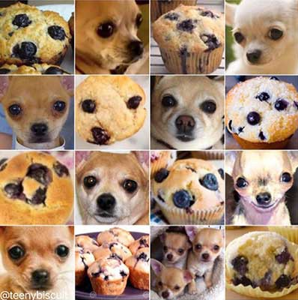
CS102 Further Computing
Semester II: 1 Lecture per week
Final Exam: 2 out of 6 Questions on Exam
Description:
Python has libraries that extend its functionality.
We will learn the basics of some important libraries, and put all this together…to dip our toes into the world of machine learning
With ML we can answer important questions like
Blueberry Muffin or Chihuahua
(We will discuss various supervised and unsupervised ML tasks including classification)

Slide 24
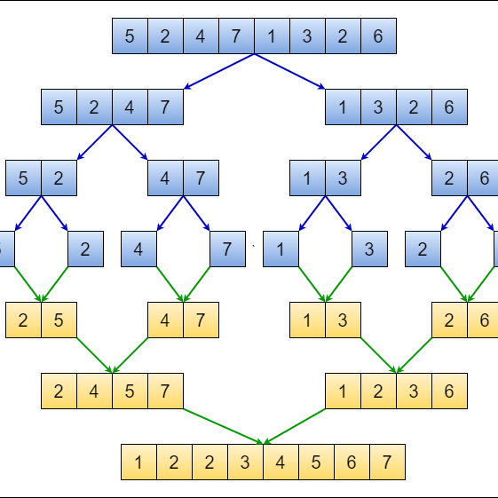
CS102 Algorithms
Contact: Dr Michael McGettrick
Tuesdays and Thursdays, Semester 2

Slide 25

Questions????

